Slide 1
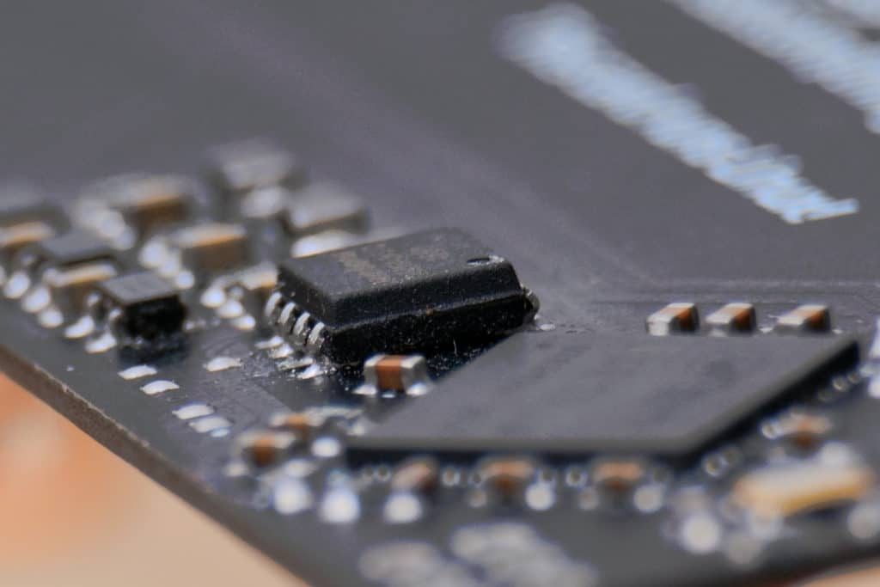
EMERGING TECHNOLOGIES IN EMBEDDED LINUX & REAL TIME PROJECTS
SUBMITTED BY: GROUP-4
Jasmine(748300)
Dixaben Shah(748229)
Stephy Baby (753812)

Slide 2
CONTENTS
Latest Operating System
Recent Hardware in Embedded System
Latest Technologies in Embedded System & its Applications.

Slide 3
FreeRTOS - Latest Operating System
FreeRTOS is considered as an open source, real time operating system for microcontrollers, which helps power devices to program in an easy manner.
One can securely connect these devices to cloud services like AWS IoT to a device like mobile and update them using OTA update feature provided by AWS IoT device management.
FreeRTOS Libraries can be easily downloaded by using AWS console or GitHub.
One can easily validate FreeRTOS device by using AWS IoT device Tester, which tests the functionality about cloud connectivity, security libraries function on microcontrollers.

Slide 4
Features Of FreeRTOS
Open Source
Trusted Kernel
Securely connected, programmed
Allow to validate FreeRTOS Devices

Slide 5
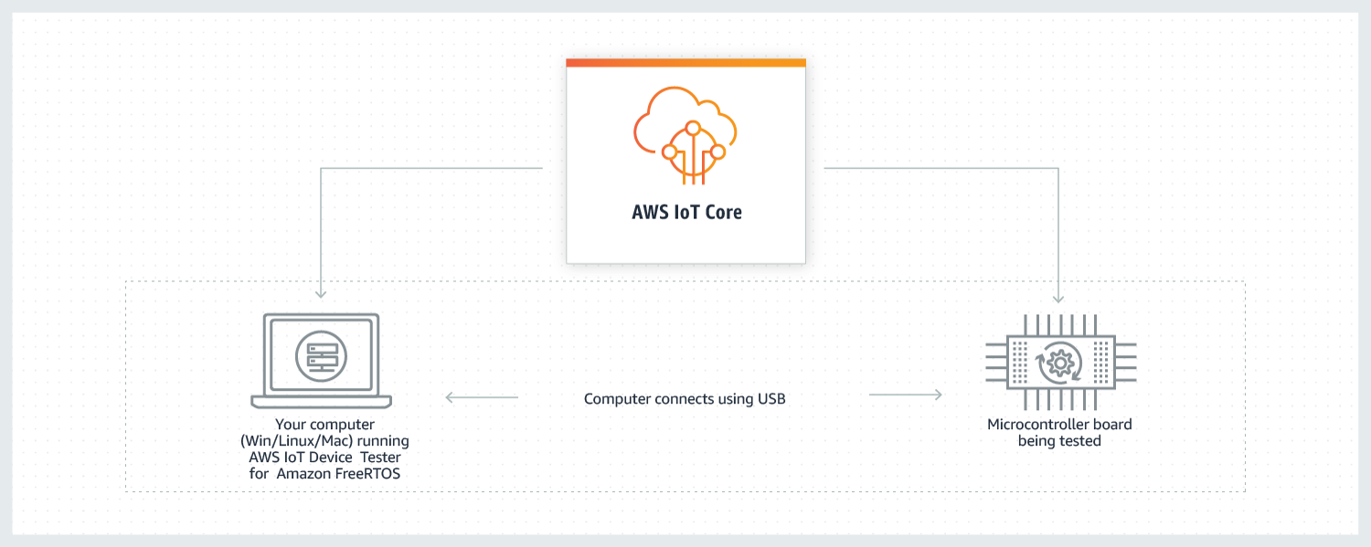
AWS IoT Device Tester
IDT for FreeRTOS is being run on host computer( Windows, Linux), which is connected to the tested board.

Slide 6
Recent Updates in FreeRTOS
FreeRTOS V10.3.1 – This updated version enhances memory protection unit ports for cores like ARM v7-M and ARM-v8-M.New libraries are released that helps in tackling IoT use cases from secure connected device to the cloud.
TrustZone is being introduced by ARM to the Cortex-M series of microcontrollers with the ARMv8-M architecture. TrustZone is a security extension feature which allows two security domains within a single processor. It allows to increase the security by providing complete isolation between trusted software and untrusted software.

Slide 7
Recent Hardware in Embedded Systems
Beaglebone Black wireless
LPC 1769

Slide 8
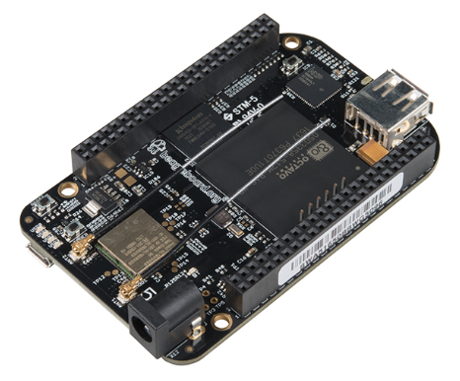
BEAGLEBONE BLACK WIRELESS
Beaglebone black wireless is a single board computer and a low-cost community-supported platform for embedded developers.
It supports all kinds of programming languages like C, C++, Perl, Java, and Python and the latest version of the beagle-bone black provides built-in wireless networking capabilities.
Latest embedded systems projects like smart electrical power analyzer, smart mirror are developed by using beagle bone in order to get fast and real time responded output.

Slide 9
KEY FEATURES OF BEAGLEBONE WIRELESS
This new version has high performance because it changes 10/100 ethernet port with onboard 802.11 b/g/n 2.4 GHz wifi and Bluetooth.
This new model introduces the octavo systems OSD3358 system in a package that helps the beagle bone to manageable BGA package.
It supports Android, Ubuntu, and open-source Linux kernel. It has the processor of AM 335X ARM Cortex A8 and 512 Mb DDR3 800MHZ RAM.
This new BeagleBone Black Wireless boots in around 10 seconds and developing through a web browser in less than 5 minutes using only one USB cable.
For recognition of objects, OpenCV and OpenNI are used.

Slide 10
LPC - Microcontroller
LPC is a family of 32 bit micro controller IC by NXP semiconductors, which are grouped into corresponding series based around the same 32 bit ARM processor core.
It always provides high performance by advanced connectivity, flexible peripherals and easiness in usage.

Slide 11
LPC 1769: FEATURES
It is a ARM cortex M3 based microcontroller which provides low power consumption, enhanced debug feature and high level integration.
It has the applications of eMetering, industrial networking, alarm systems and motor control.
It has on chip SRAM which includes 32 or 16 kB of SRAM on the CPU with local data bus for high-performance CPU access.

Slide 12
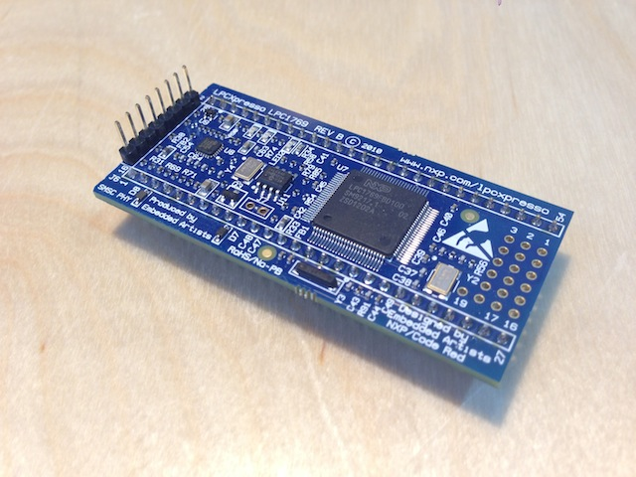
APPLICATIONS
Projects involving alarm systems, controlling motor. Example includes wifi based smart home system.

Slide 13
Latest Trends in Embedded System
Embedded Security
Real - time Visualization

Slide 14
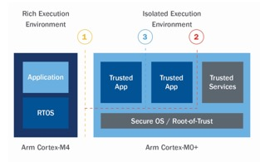
EMBEDDED SECURITY
New Cypress PSoc 6 recently came into existence as a security solution. It includes multiple ARM Cortex-M cores on the device. First core is introduced as a cortex-M0 that acts as a security processor which build Trusted execution environment and with the help of this, all secure operations are kept isolated.
The second core named as Cortex-M4, is operated as non-secure performance core for software operations.

Slide 15
Real Time Visualization
This application developer to visualize the tasks or events in RTOS based application that includes switching the contents between tasks.
Earlier it was only possible to go through data after it was recorded in the system. But tacking real time data in live context is possible.
Along with this state machines can also be visualized.

Slide 16
REFERENCES
BeagleBone Black Wireless. (n.d.). Retrieved from https://beagleboard.org/black-wireless
LPC1769 Datasheet PDF. (n.d.). Retrieved from https://datasheetspdf.com/datasheet/LPC1769.html
BeagleBone Black Wireless Single Board Computer Based on Sitara AM335x. (2016, September 29). Retrieved from https://www.element14.com/community/docs/DOC-83315/l/beaglebone-black-wireless-single-board-computer-based-on-sitara-am335x
Latest Technology in Embedded Systems and Applications. (2019, March 2). Retrieved from https://embeddedschool.in/latest-technology-in-embedded-systems-and-applications/
Freertos. (2012). Retrieved from https://aws.amazon.com/freertos/

